Slide 1

Getting started with NoSQL in .NET using RavenDB
Ondrej Balas @ondrejbalas

Slide 2
Getting started with NoSQL in .NET using RavenDB
2
Ondrej Balas @ondrejbalas

Slide 3


Ondrej Balas
Husband & Father
MVP (C#), Writer for Visual Studio Magazine
Owner of UseTech Design
I build software that drives business
Blog: http://www.ondrejbalas.com Twitter: @OndrejBalas

Slide 4
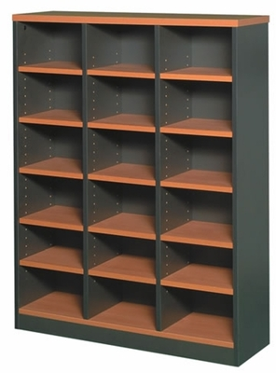



It’s a Document Database!
Any type of object can be stored
Serializes to JSON
Notes:
Store Documents instead of Rows, and Collections instead of Columns

Slide 5
It’s a Document Database!
Any type of object can be stored
Serializes to JSON
{
"Id": "Customers/1",
"Name": "Emily",
"Address": "123 Oak St",
"City": "Boston",
"PrefferedCustomer": true
}
{
"Id": "Products/1",
"Name": "Ice Cream",
"Price": 4.25
}
{
"Id": "Products/2",
"Name": "Book with Lamp",
"Price": 89.95
}
Notes:
Store Documents instead of Rows, and Collections instead of Columns

Slide 6


It’s a Document Database!
Any type of object can be stored
Serializes to JSON
Notes:
Store Documents instead of Rows, and Collections instead of Columns

Slide 7
Example: Storing a Blog
class BlogPost
{
public string Title { get; set; }
public List<string> Tags { get; set; }
}

Slide 8
Storing a Blog Post
BlogPosts
blog_id | title
1 | Raving about Raven
BlogTags
blog_id | tag_id
1 | 1
1 | 2
Tags
tag_id | tag_text
1 | ravendb
2 | ondrej

Slide 9
Storing a Blog Post
BlogPosts
blog_id | title
1 | Raving about Raven
BlogTags
blog_id | tag_id
1 | 1
1 | 2
Tags
tag_id | tag_text
1 | ravendb
2 | ondrej

Slide 10
Storing a Blog Post
BlogPosts
blog_id | title
1 | Raving about Raven
BlogTags
blog_id | tag_id
1 | 1
1 | 2
Tags
tag_id | tag_text
1 | ravendb
2 | ondrej

Slide 11
Storing a Blog Post
{
"Title": "Raving about Raven",
"Tags": [
"ravendb",
"ondrej"
]
}

Slide 12
Storing a Blog Post
RavenDB
{
"Title": "Raving about Raven",
"Tags": [
"ravendb",
"ondrej"
]
}
SQL Equivalent
Raving about Raven
ravendb
ondrej

Slide 13
Storing a Blog Post
RavenDB
{
"Title": "Raving about Raven",
"Tags": [
"ravendb",
"ondrej"
]
}
SQL Equivalent
BlogPosts
blog_id | title
1 | Raving about Raven
BlogTags
blog_id | tag_id
1 | 1
1 | 2
Tags
tag_id | tag_text
1 | ravendb
2 | ondrej

Slide 14




The Castle Project
Oren Eini
(Ayende)
Notes:
Cascading deletes – customer profile with notes

Slide 15
ORM Object-relational mapper

Slide 16
Impedance Mismatch
Relational model
Tables, Columns, Rows
Object model
Objects

Slide 17
Select N+1
10 Customers with 3 Orders each
Hand-written SQL
SELECT * FROM CUSTOMER INNER JOIN ORDER ON CUSTOMER.ID = ORDER.CUSTOMER_ID
Possible ORM-generated SQL
SELECT * FROM CUSTOMER; SELECT * FROM ORDER WHERE ORDER.CUSTOMER_ID = 123; SELECT * FROM ORDER WHERE ORDER.CUSTOMER_ID = 124; SELECT * FROM ORDER WHERE ORDER.CUSTOMER_ID = 125; # ETC..

Slide 18


Slide 19
Performance
SQL is optimized for WRITEs

Slide 20
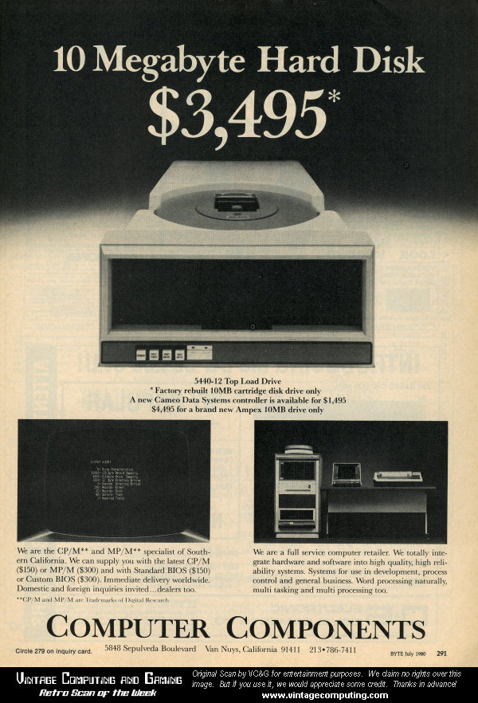
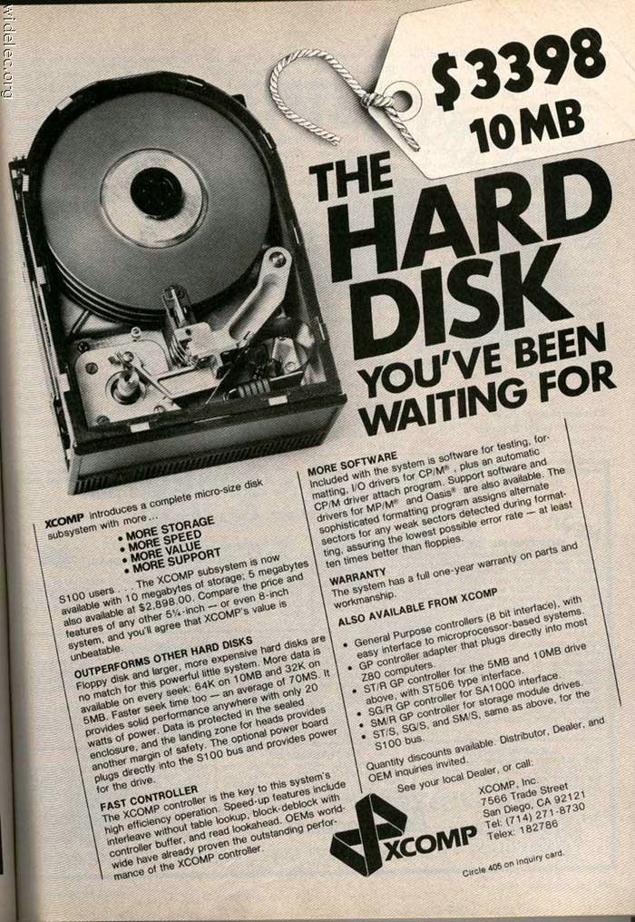

Slide 21
Performance
SQL is optimized for WRITEs
RavenDB is optimized for READs

Slide 22
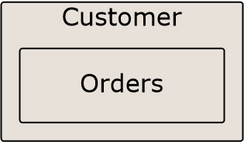
Think Aggregates

Slide 23
Reporting

Slide 24
Let’s get started!

Slide 25
Setting up a Server
NuGet
or
http://ravendb.net

Slide 26
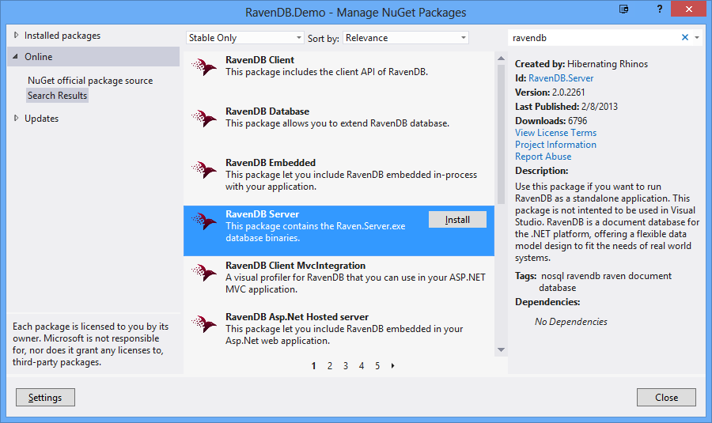
RavenDB Server on Nuget

Slide 27
Interesting Parts
1 Backup

Slide 28
Interesting Parts
1 Backup
1 Bundles

Slide 29
Interesting Parts
1 Backup
1 Bundles
1 Client

Slide 30
Interesting Parts
1 Backup
1 Bundles
1 Client
1 EmbeddedClient

Slide 31
Interesting Parts
1 Backup
1 Bundles
1 Client
1 EmbeddedClient
1 Samples

Slide 32
Interesting Parts
1 Backup
1 Bundles
1 Client
1 EmbeddedClient
1 Samples
1 Server

Slide 33
Interesting Parts
1 Backup
1 Bundles
1 Client
1 EmbeddedClient
1 Samples
1 Server
1 Smuggler

Slide 34
Interesting Parts
1 Backup
1 Bundles
1 Client
1 EmbeddedClient
1 Samples
1 Server
1 Smuggler
3 Start.cmd

Slide 35
Interesting Parts
1 Backup
1 Bundles
1 Client
1 EmbeddedClient
1 Samples
1 Server
1 Smuggler
3 Start.cmd

Slide 36
Inside the Server folder
3 Raven.Server.exe
3 Raven.Server.exe.config
1 Data
1 Logs
1 Tenants
Notes:
Looks scary, but only

Slide 37
Inside the Server folder
3 Raven.Server.exe
3 Raven.Server.exe.config
1 Data
1 Logs
1 Tenants
Notes:
Looks scary, but only

Slide 38
Configuration File
<appSettings>
<add key="Raven/Port" value="*"/>
“*” Or a number; “*” means port 8080 or next available
<add key="Raven/DataDir" value=" ~\Database\System "/>
<add key="Raven/AnonymousAccess" value=“Admin"/>
Options are Admin, Get, All, and None
</appSettings>

Slide 39
More options
Raven/MaxPageSize (Default: 1024)
Raven/RunInMemory (Default: false)
Raven/TransactionMode (Default: Safe) (Lazy = Can lose data on crash)
Raven/HostName (Default: None)
Raven/PluginsDirectory (Default: “~\Plugins”)

Slide 40

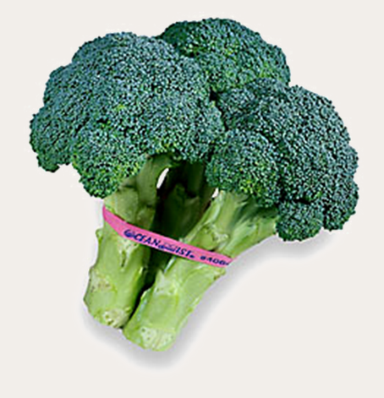
Bundles!
Sharding & Replication
Expiration
Versioning
More Like This
Unique Constraints

Slide 41
Now for the fun stuff
Notes:
Demo time!!!!

Slide 42
Index: Temp/Products/ByCategory
Categories Documents
Office Supplies
products/Stapler
Furniture
products/Tape
products/Paper
products/Chair
products/Desk

Slide 43
Transactions
Implicit or Explicit
Atomic, Isolated, and Durable
Eventual Consistency
Immediate Consistency Possible

Slide 44
Consistency - Load vs. Query
Indexes can be stale
Use load for immediate consistency
Take advantage of Id naming

Slide 45
Query without Querying
session.Advanced
.LoadStartingWith<BlogPost>
("blogposts/2012-10");
session.Load<BlogPost>(Enumerable.Range(10, 7)
.Select(i =>
string.Format("2012-10-{0:00}", i)));

Slide 46
Handling Schema Changes
Adding Properties
Removing Properties
Modifying Properties

Slide 47
Adding Properties
Add to model
Set it in the constructor

Slide 48
Removing Properties
Remove it from your model
RavenDB will self-cleanse

Slide 49
Modifying Properties
Load, change, and store each object
Use the Patch API
Extension point: IDocumentConversionListener
DocumentStore.RegisterListener()

Slide 50
Safe by Default
Unbounded result sets
Unbounded number of requests
Notes:
Page size is 128 if unspecified, and 1024 is default maximum || 30 requests per session maximum

Slide 51
Licensing
http://ravendb.net/licensing
Free for Development
Free for Open Source
Commercial Use recently changed status to “It’s Complicated”
Still much cheaper than SQL Server

Slide 52
Ready to play?
Check out the Sample Data

Slide 53
Thanks! Resources http://bit.ly/RavenLinks
Questions? Find me at:
Twitter - @ondrejbalas
Blog - ondrejbalas.com
ondrej@ondrejbalas.com
Notes:
Hope I’ve inspired you.

